Slide 1
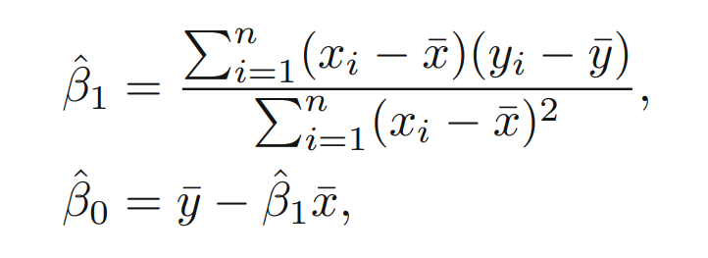




APPENDIX 1- LOGISTIC REGRESSION
In Linear Regression we predict Y (a response variable) using X (a predictor variable). We assume that:
We will then estimate the parameters with Least Squares Method. The result is:
${Y=β}_{0}+β_{1}X$
The function takes the form of a line:
$$Y$$
Linear regression is not used to predict probabilities as the predicted value can be negative (less than 0) or more than 1 while a probability always takes a value between [0,1].
Although it is actually possible to do, it is not a popular method.
$β_{0}$
$$X$$

Slide 2

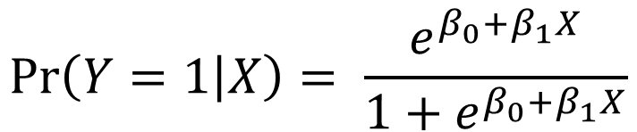



APPENDIX 1
In Logistic Regression we are trying to predict the probability that an observation X falls into a specific category (Y is a categorical variable). We assume that:
We estimate the parameters using the Maximum Likelihood method. The function is shaped like an S:
$$\operatorname{Pr}\left(Y=1 | X\right)= \frac{e^{β_{0}+β_{1}X}}{1+e^{β_{0}+β_{1}X}}$$
$$Pr(Y=1|X)$$
$$1$$
This is called the Logistic Function. It always takes a value between [0,1].
$$0$$
$$X$$

Slide 3
APPENDIX 1

